Slide 1


Flavors of Insight: Zomato Restaurant Analytics
Name: M. Vani
Batch no: 435
Innomatics research labs

Slide 2
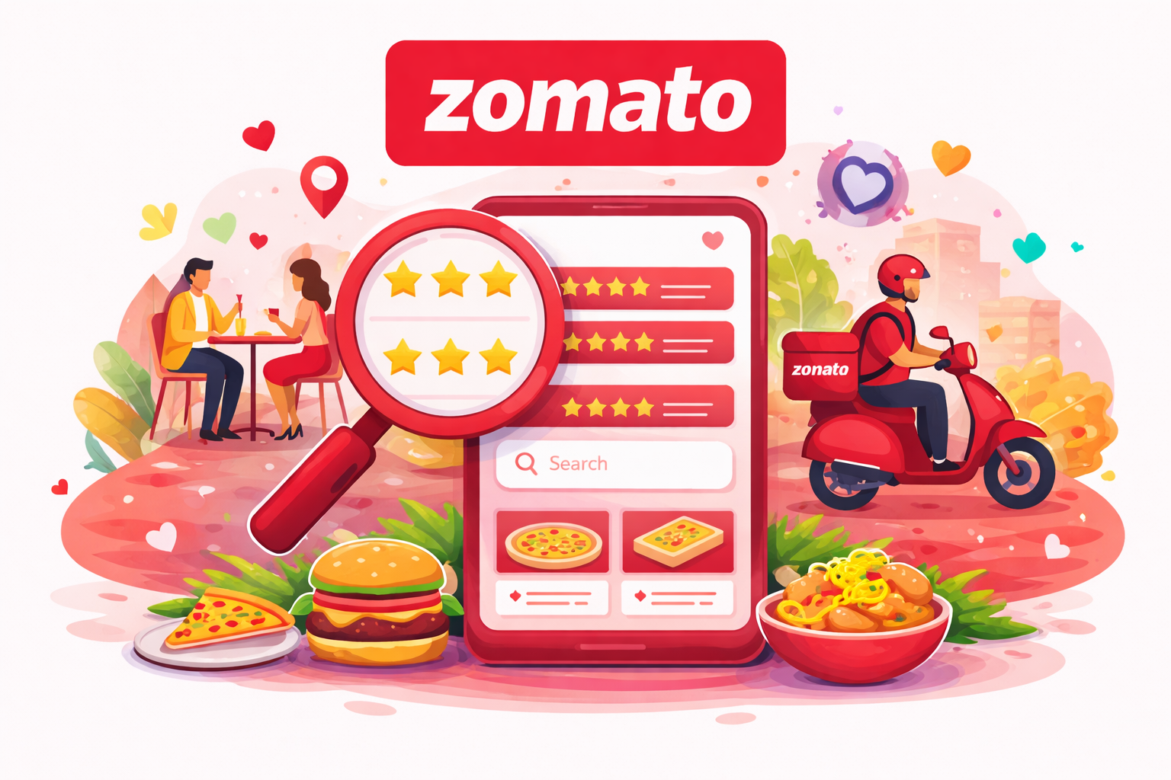
Agenda
Introduction
Business Problem
Problem Statement
Business Objective
Data Collection
Data Cleaning
Analysis
Recommendations &
Insights
Conclusion

Slide 3

Introduction
Zomato, launched in 2008, is one of India’s leading online food delivery and restaurant discovery platforms, where users explore restaurants, cuisines, ratings, and pricing options across various cities. It provides detailed information that helps customers make informed dining and ordering decisions.

Slide 4
Business Problem
Restaurant owners and food businesses often do not clearly understand customer preferences, suitable pricing, high-demand areas, and their competitors because the data is not available in a structured format. This makes analysis difficult and affects proper business decision-making.
Problem Statement
Restaurant owners and food businesses find it difficult to analyze customer preferences, pricing trends, demand, and competition because Zomato data is not available in a structured format. This project scrapes and organizes Zomato restaurant data to enable meaningful analysis and support better business decisions.

Slide 5
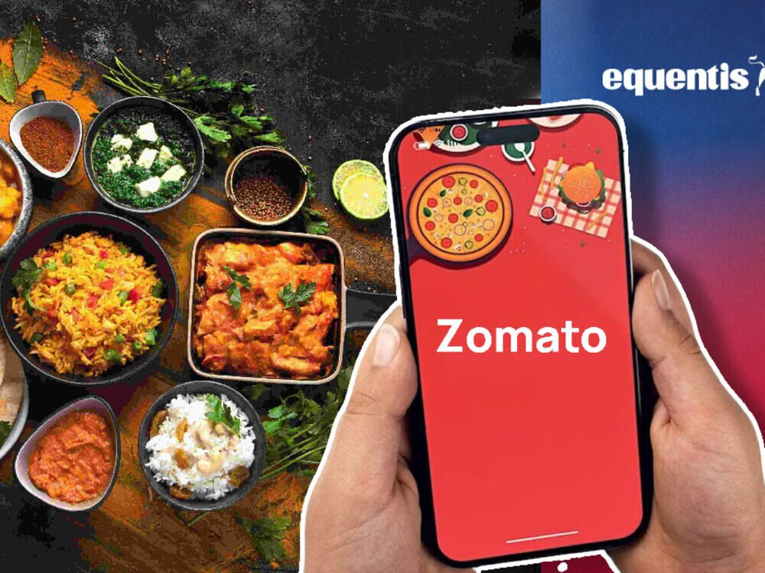
Business Objective
The objective of this project is to scrape restaurant data from Zomato and organize it into a structured format. This helps analyze customer preferences, pricing trends, and competition to support better business decisions.

Slide 6
Data Collection
Scraped restaurant data from Zomato using Python (Selenium)
Collected 2000+ restaurant records across multiple locations
Extracted 6 columns: Restaurant Name, Location, Cuisine, Cost for Two, Rating, Delivery Time
Cleaned and preprocessed data (handled missing values and duplicates)
Performed analysis on ratings, pricing, and cuisine trends
Visualized insights using charts and graphs
Identified top-rated and affordable restaurants
Generated key insights and recommendations

Slide 7
Data Cleaning
Identified missing values across all columns using isnull().sum()
Observed missing data in Restaurant, Rating, Cuisine, Price_for_Two, and Delivery_Time columns
Imputed missing Delivery Time values by replacing them with the most frequent (mode) delivery time for each location
Filled missing Cuisine values using the most common cuisine type within the same location
Filled missing Price_for_Two values using the mode price for each respective location
Removed rows with missing Restaurant names to maintain data integrity
Ensured all missing values were handled and verified data cleanliness using a final null check
Prepared a complete and consistent dataset for further analysis and visualization

Slide 8
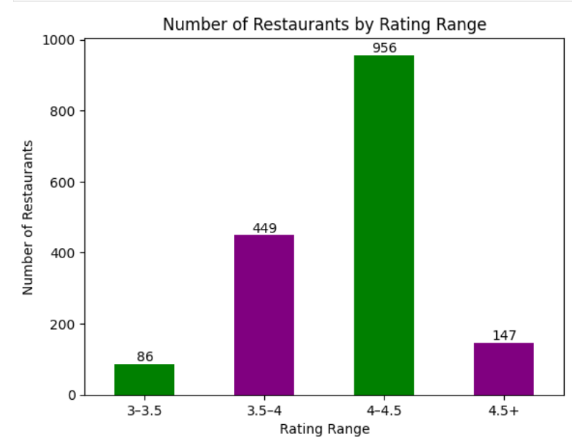
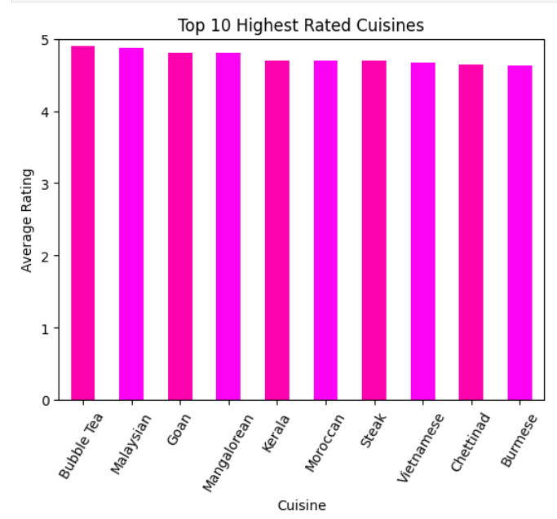
Visualizations
Which rating range (3–3.5, 3.5–4, 4–4.5, 4.5+) has the most restaurants?
Which cuisines have the highest average ratings?
INSIGHT: Top-rated cuisines show consistently high and closely clustered ratings, indicating strong customer satisfaction across all.
INSIGHT: "Most restaurants have ratings between 4 and 4.5, indicating generally high customer satisfaction.."

Slide 9
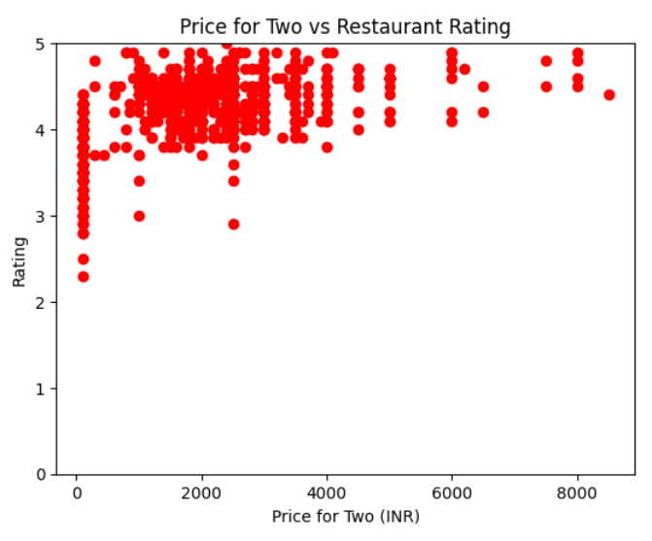
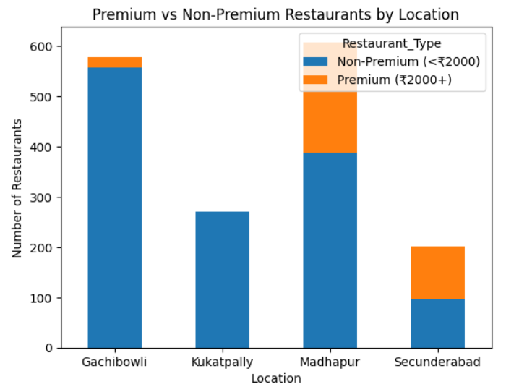
Are higher-priced restaurants rated better?
Do premium restaurants dominate certain locations?
INSIGHT: High ratings appear across all price ranges, showing no strong link between price and customer ratings.
INSIGHT : Gachibowli and Madhapur have more premium restaurants, Kukatpally is mostly non-premium, while Secunderabad shows a balanced mix.

Slide 10
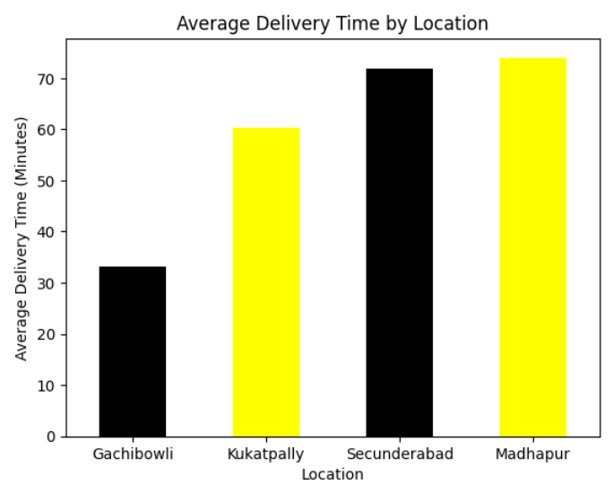
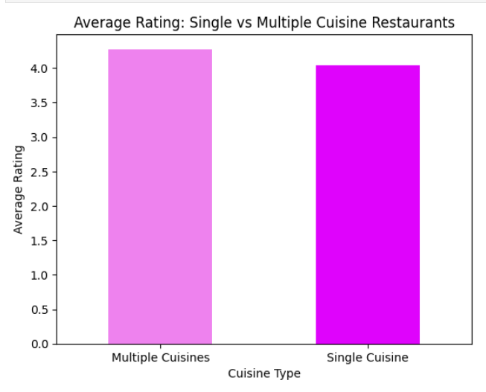
Which locations have faster delivery times on average?
Do restaurants with multiple cuisines have better ratings than single-cuisine restaurants?
INSIGHT : Gachibowli has the fastest deliveries, while Madhapur and Secunderabad have the slowest.
INSIGHT : Restaurants offering multiple cuisines tend to have slightly higher average ratings

Slide 11
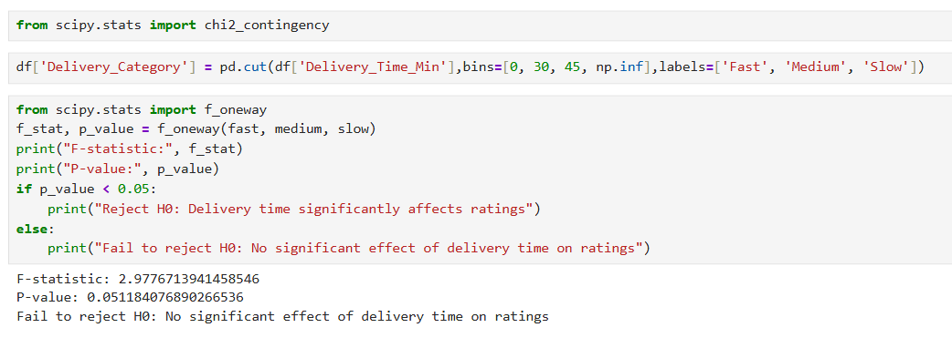
Hypothesis Testing
Does delivery time significantly affect restaurant ratings?

Slide 12
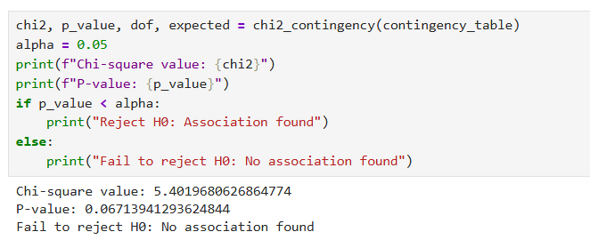
Is restaurant type (Premium vs Non-Premium) associated with location?

Slide 13

Recommendations & Insights
Rating vs Price Insight
Insight: Restaurants with moderate pricing often receive higher customer ratings compared to very cheap or very expensive restaurants.
Recommendation: Users should prefer mid-range restaurants for better quality-to-price value, while restaurant owners should focus on maintaining quality rather than extreme discounts.
Location-Based Delivery Efficiency
Insight: Delivery time varies significantly by location, indicating that some areas have more efficient delivery networks.
Recommendation: Zomato can optimize delivery partner allocation in high-delay locations to improve customer satisfaction.

Slide 14
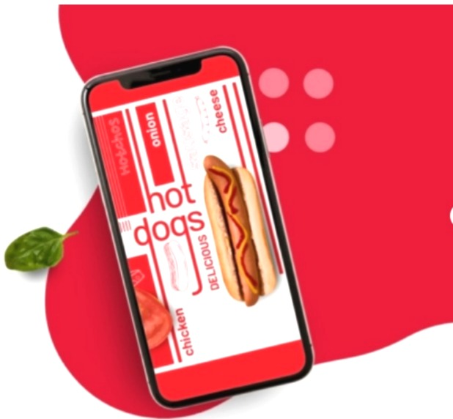
Recommendations & Insights
Cuisine Popularity Insight
Insight: Certain cuisines dominate specific locations, reflecting local food preferences.
Recommendation: New restaurants should offer popular local cuisines in each area to increase visibility and demand.
High Ratings ≠ High Prices
Insight: Several affordable restaurants still maintain high ratings, proving that good quality does not always require high pricing.
Recommendation: Customers can identify budget-friendly, high-rated options, and businesses can use this strategy to attract price-sensitive users.

Slide 15
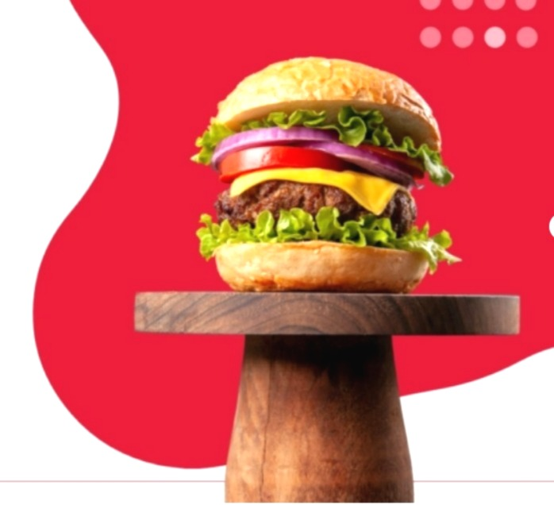
Recommendations & Insights
Consistent Patterns Within Locations
Insight: Restaurants within the same location show similar pricing, delivery times, and cuisine patterns, indicating strong regional trends.
Recommendation: Zomato can provide location-based recommendations and personalized suggestions to users for better engagement.

Slide 16
Conclusion
Collected 2000+ restaurant records from Zomato using web scraping and analyzed the data using Python.
Cleaned and preprocessed the dataset with 6 key attributes to ensure data accuracy and consistency.
Performed Exploratory Data Analysis (EDA) to uncover patterns in ratings, pricing, cuisines, delivery time, and locations.
Identified that affordable and mid-range restaurants tend to receive higher ratings, with delivery efficiency varying by location.
Generated actionable insights to help customers choose better restaurants, restaurants optimize performance, and platforms improve recommendations.

Slide 17


Slide 18


